Slide 1


SQL Safari Gamified Learning for SQL
A new way to learn databases
Student ID – st20328096– KD/BSCSD/19/05
Name: Galketihenege Krishan Chamara Abeywardhana
Notes:
sfdsadf

Slide 2

Content
Why SQL?
The Current Problem.
What’s Gamified Learning?
What’s Adaptive Difficulty?
Traditional Vs Gamified Learning.
What’s SQL Safari?
Technology Stack
Future Improvements
Notes:
Fsdfasdf
sdfsadf

Slide 3

Why SQL?
SQL is the language of databases.
Used in many field.
Essential for data analysis.
Notes:
afdsaf

Slide 4

Current Problem
Students find learning SQL is boring.

Slide 5

Why Gamified Learning?
Learning feels like playing a game.
Increases motivation & engagement.

Slide 6
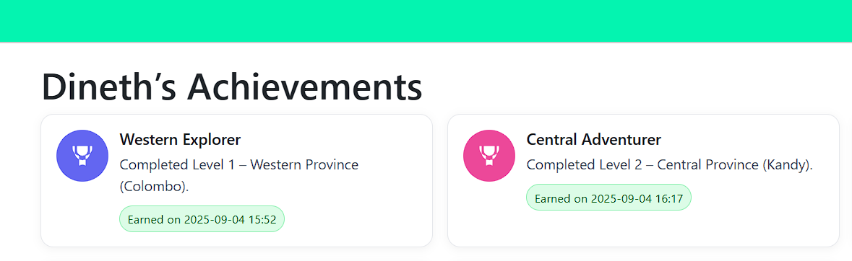
Why Gamified Learning? Contd..
Rewards.
Progress tracking.

Slide 7

Adaptive Difficulty
If a student struggles show hints, easier steps.
Game adjust difficulty level by level.

Slide 8
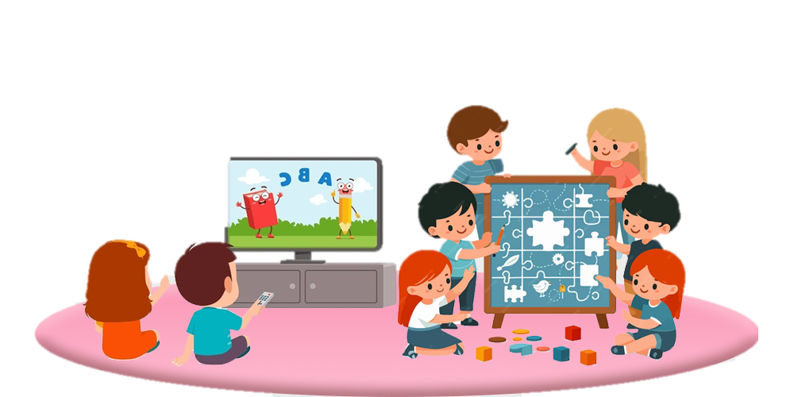

Traditional vs Gamified Learning
Traditional: lectures, fixed exercises, low engagement.
Gamified: story-driven, interactive, rewarding.

Slide 9


What is SQL Safari?
A narrative-driven game across Sri Lanka’s provinces.
Each province is a level.
Players complete SQL tasks to level up.
Immediate feedback, hints, and achievements.

Slide 10

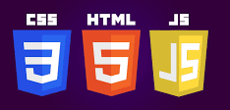
Technology Stack
Backend:
PHP(Laravel)
Frontend:
HTML
CSS
Bootstrap
JS
Database: MySQL.

Slide 11
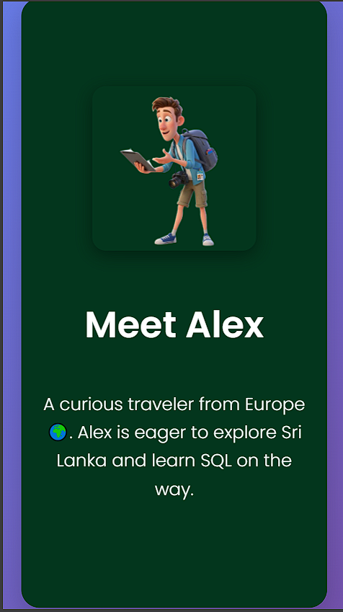
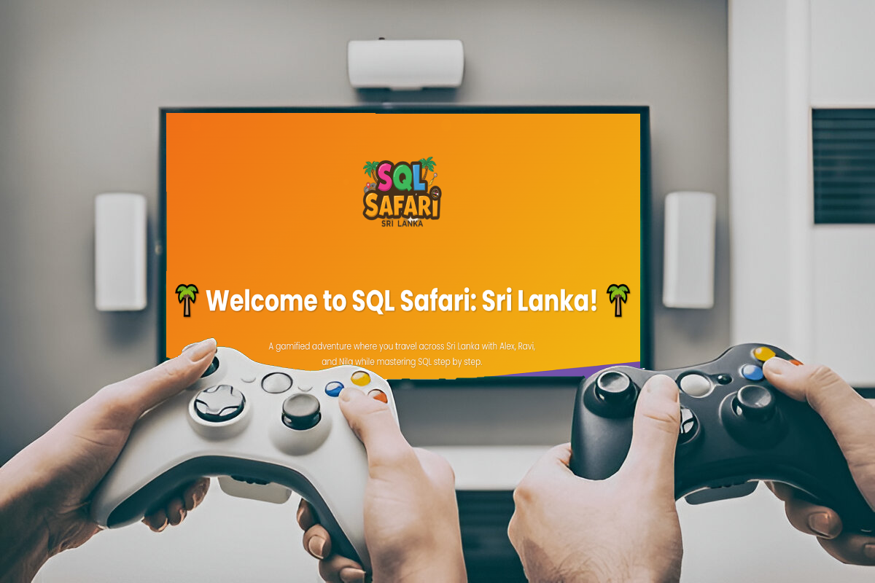
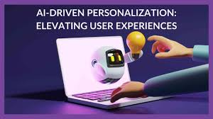
Future Improvements
Multiplayer challenges.
AI-driven personalized hints.
Mobile app version.

Slide 12

Students find learning SQL is boring.
With SQL Safari, learning feels like playing a game.

Slide 13
Thank You

